Slide 1


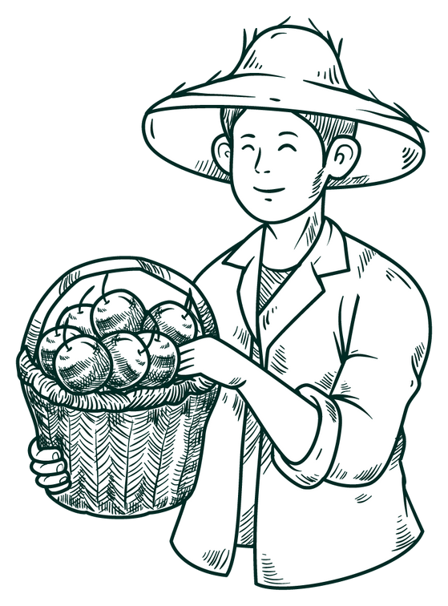




Aahar
Smart Irrigation and Farm monitoring system
Team Members
Sanjib SHah
aman sheikh
manish paudel

Slide 2
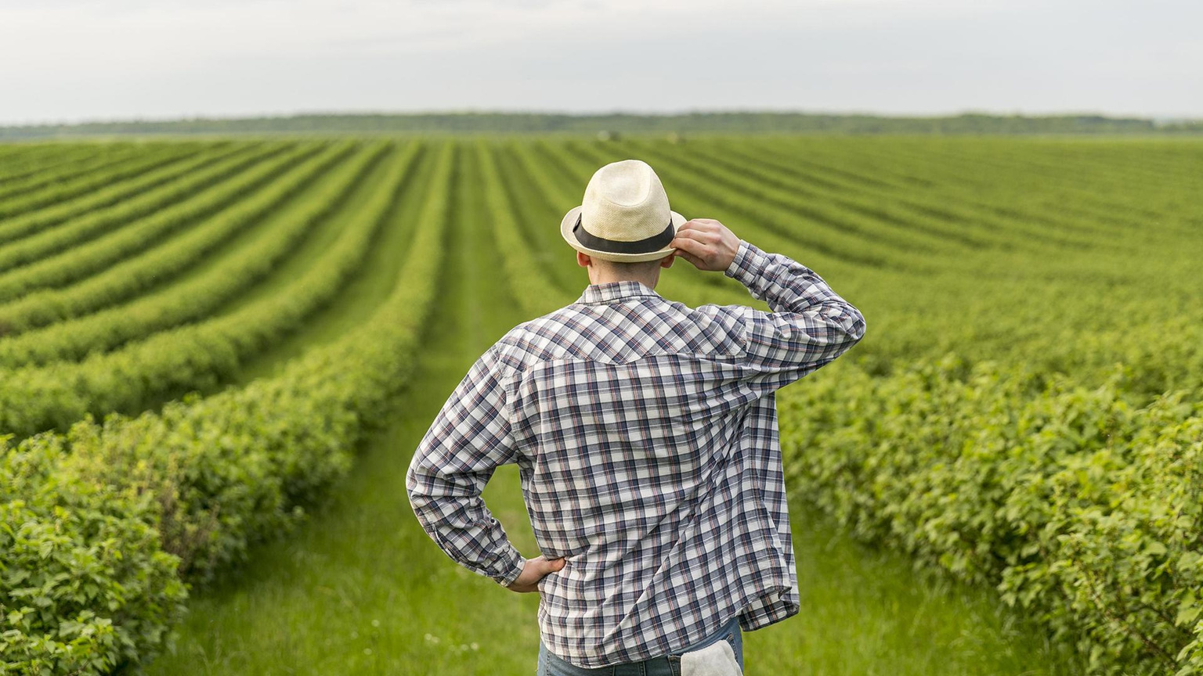


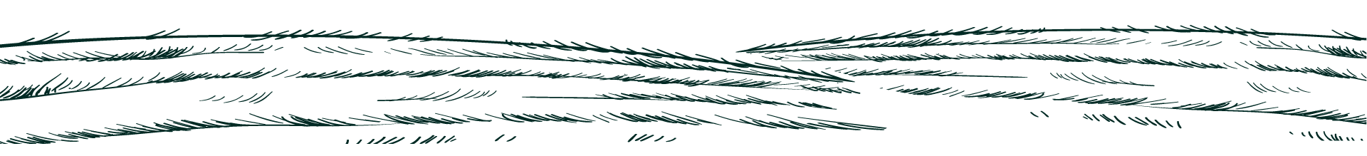
Problem Statement
Inefficient water management due to lack of soil moisture and weather data.
Manual motor pump operation increases water, energy wastage and risky and unsafe at night.
Difficulty in early detection of plant diseases or conditions.
Crops are vulnerable to damage from animals without effective deterrents.
Limited access to timely agricultural news and weather updates.
Absence of an integrated platform for smart irrigation, monitoring, and crop protection.

Slide 3







Objective
Smart Irrigation
Real-Time Monitoring
Automate, schedule, or manually control motor pumps using IoT for efficient water management.
Provide soil fertility, moisture, and weather data via a Flutter app.
Precision Land Leveling
Plant Health Diagnosis
Utilize laser-guided systems for efficient land preparation.
Detect plant diseases or conditions using leaf analysis technology.
News and Updates
Agricultural Tracking
Deliver timely national and international agricultural news in the app.
Monitor and store data on expenses, fertilizers, and crops to provide clarity on farming activities and investments.

Slide 4
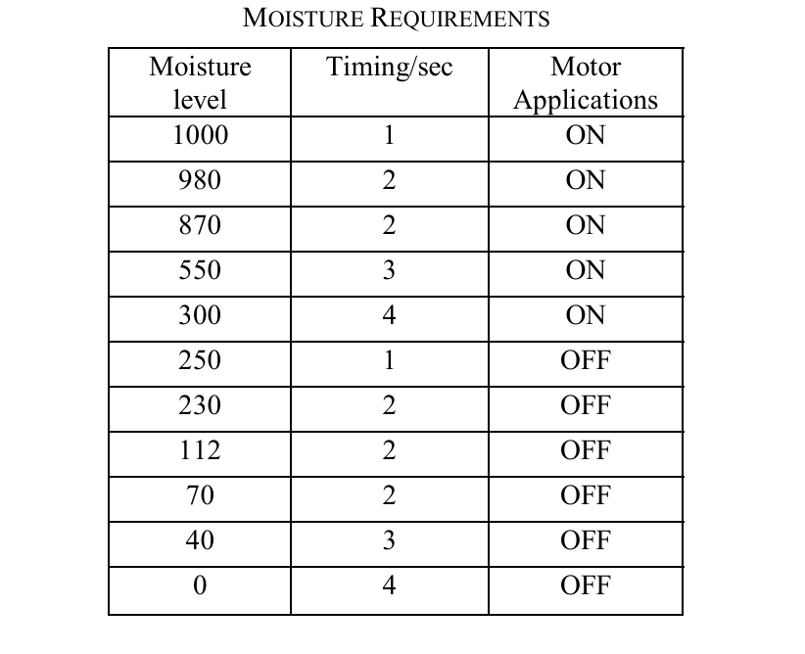
Literature Review

Slide 5
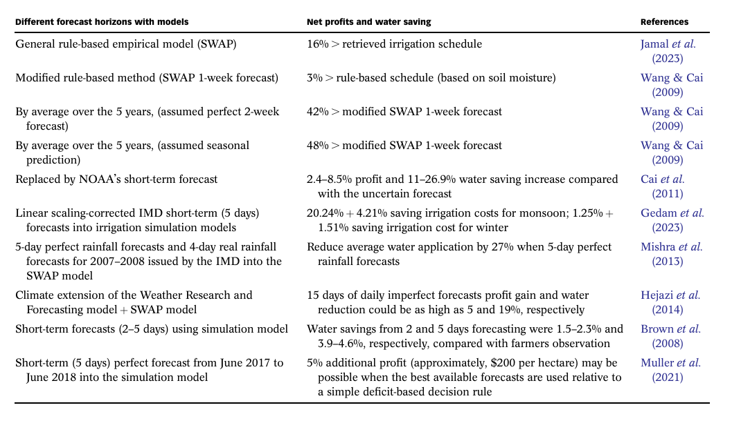
Literature Review

Slide 6
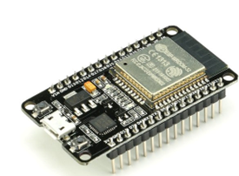

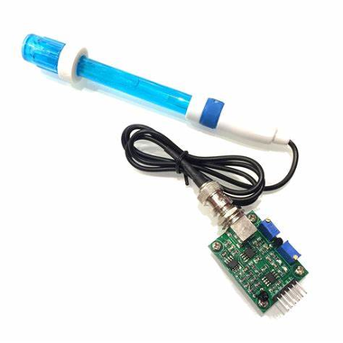
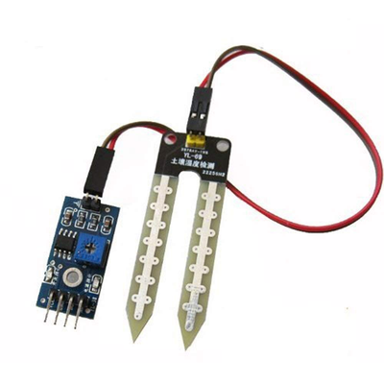

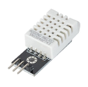

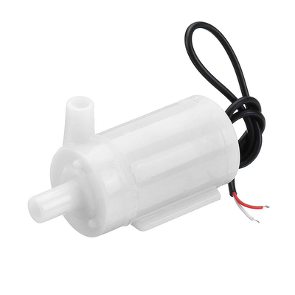
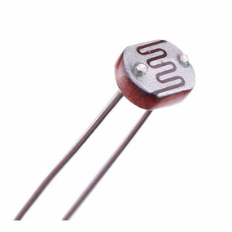
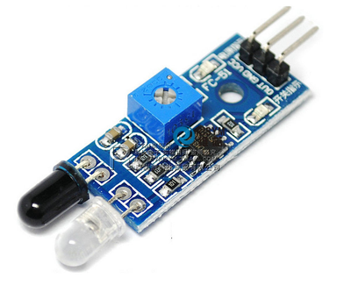

Hardware material
esp32
PH sensor
Soil Moisture Sensor
DHT22
LDR
Pump Motor
LED blub
IR Sensor

Slide 7

Advantages
Automated irrigation reduces water and energy wastage.
Precise soil, weather, and disease monitoring boosts productivity.
Remote motor control minimizes night-time risks.
Integrated data supports better farming decisions.

Slide 8




Future Scope
Crop Recommendation
Neural Networks
Monitoring
AI-based systems to recommend the best crops based on soil and weather data.
Improve image classification models for more accurate plant disease detection.
Expand sensor integration for detailed tracking of soil and environment.

Slide 9
Thank You

